Slide 1
LOGIN 360
SUBMITED BY
- MOHANPRASATH S

Slide 2
PROJECT TITTLE
* BULIDUING A WORDPRESS
WEBSITE ON USING AMAZON
EC2 INSTANCES
*

Slide 3
# OVERVIEW
Stack: Set up the (Linux, Apache, MySQL, PHP,Mariadb) stack on your EC2 instance.
WordPress Installation: Install and configure WordPress on your EC2 server. to run the wordpress application

Slide 4
EC2 CONNECTION METHOD
EC2 NAME
INSTANCE TYPE [ t2 micro,freetier]
KEYPAIR (.PEM)
SECURITY GROUP
[ SSH , HTTP ,HTTPS , MYSQL AURORA ]
TO LAUNCH THE INSTANCES SUCCESFULLY

Slide 5
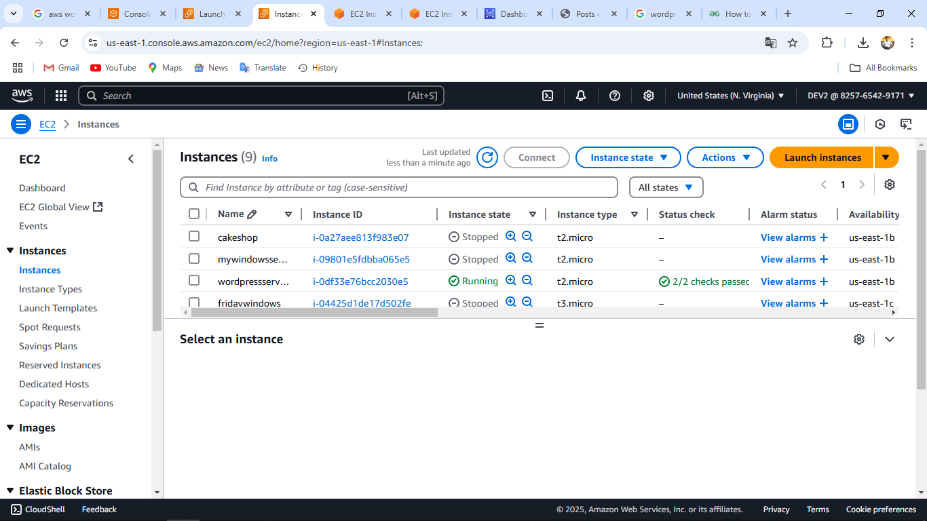
EC2 CONNECTIONS

Slide 6
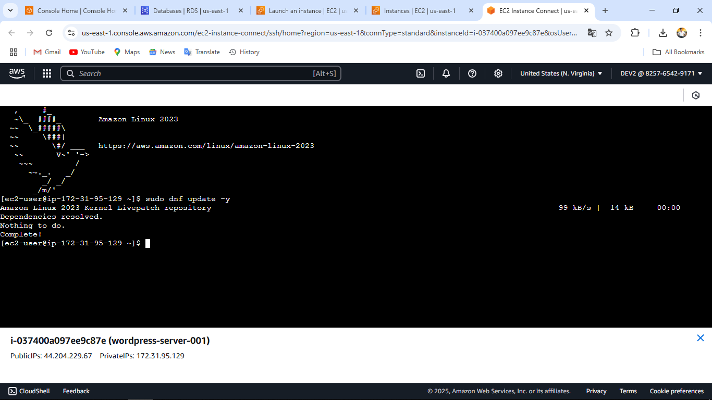
UPDATE THE SYSTEM COMMANDS

Slide 7
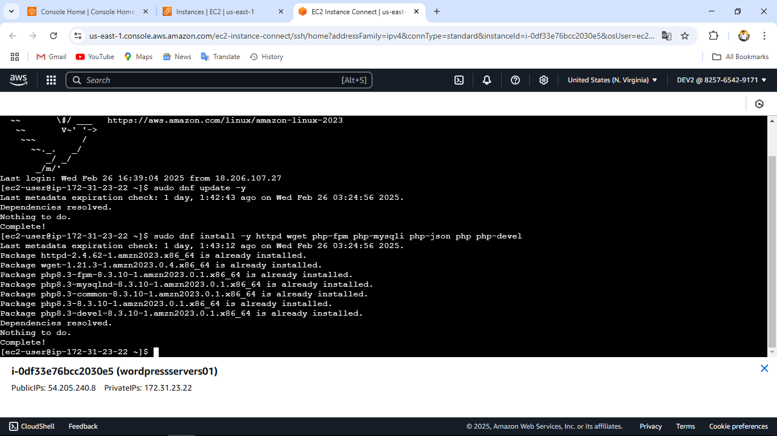
Install Apache, PHP, and MariaDB

Slide 8
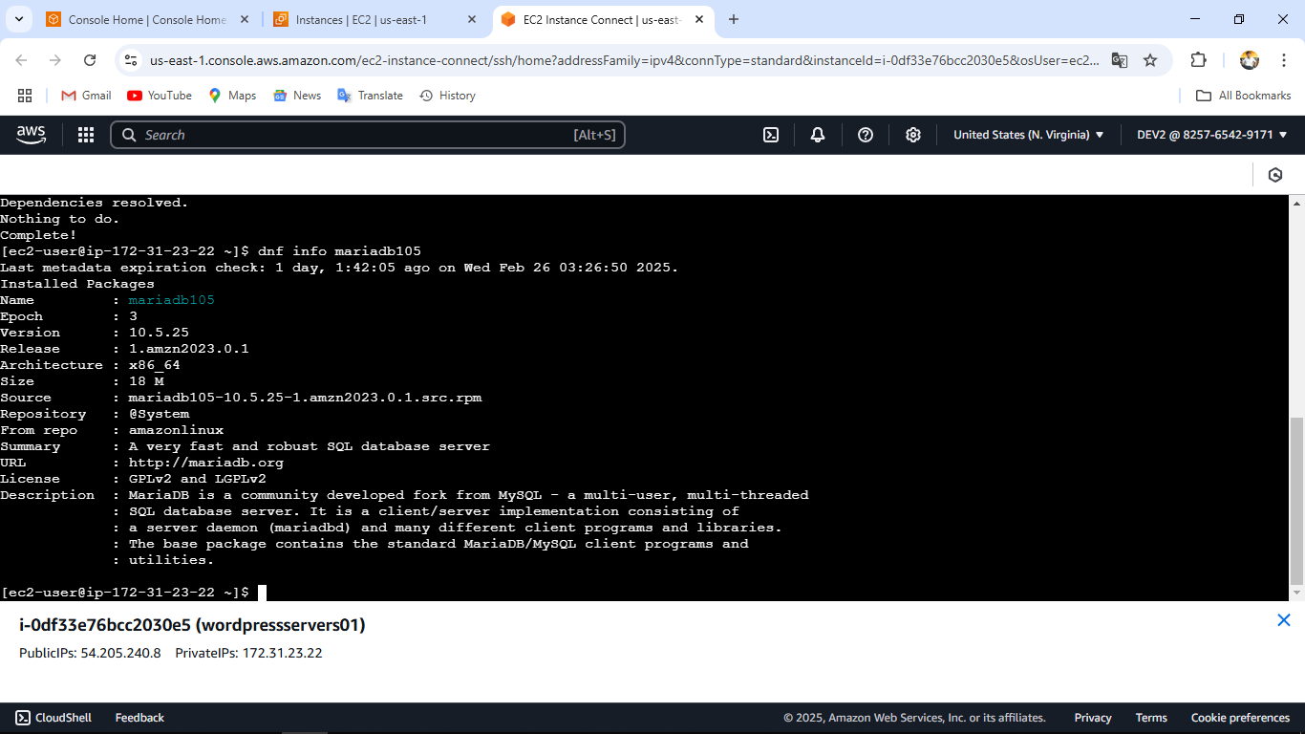
..

Slide 9
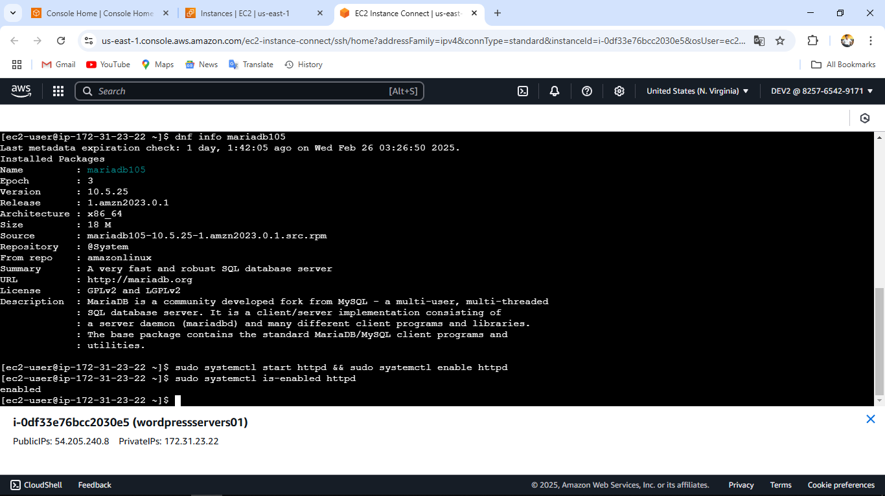
Configure Permissions

Slide 10
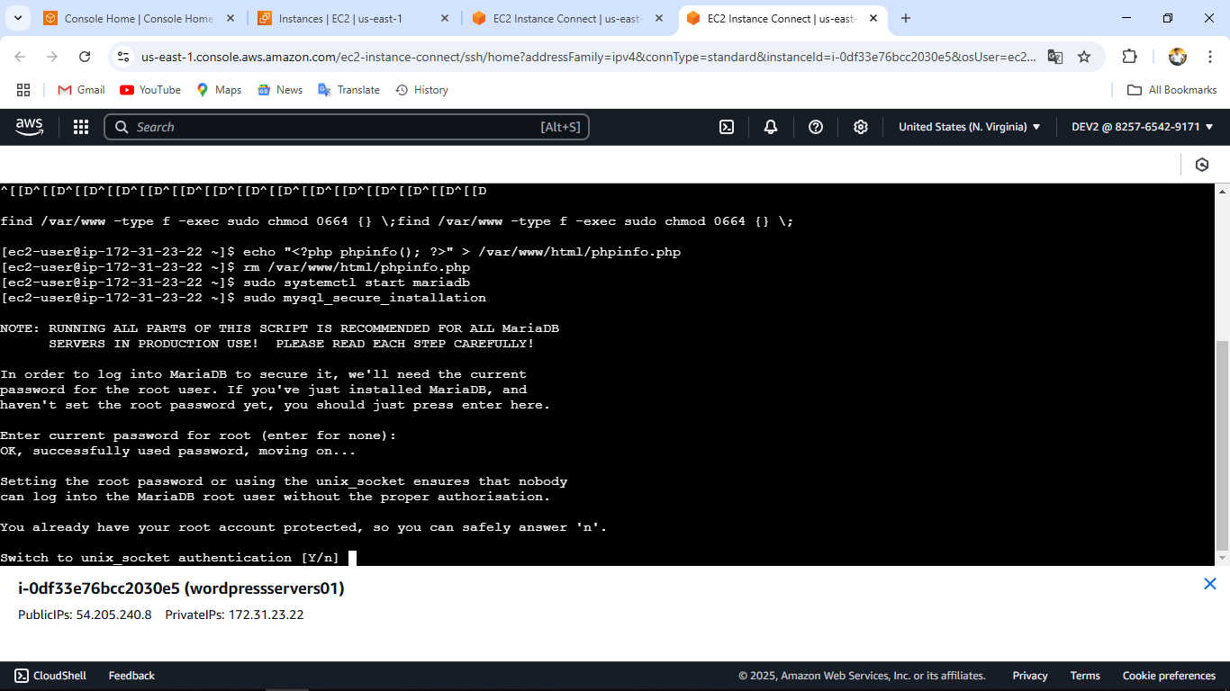
. .

Slide 11
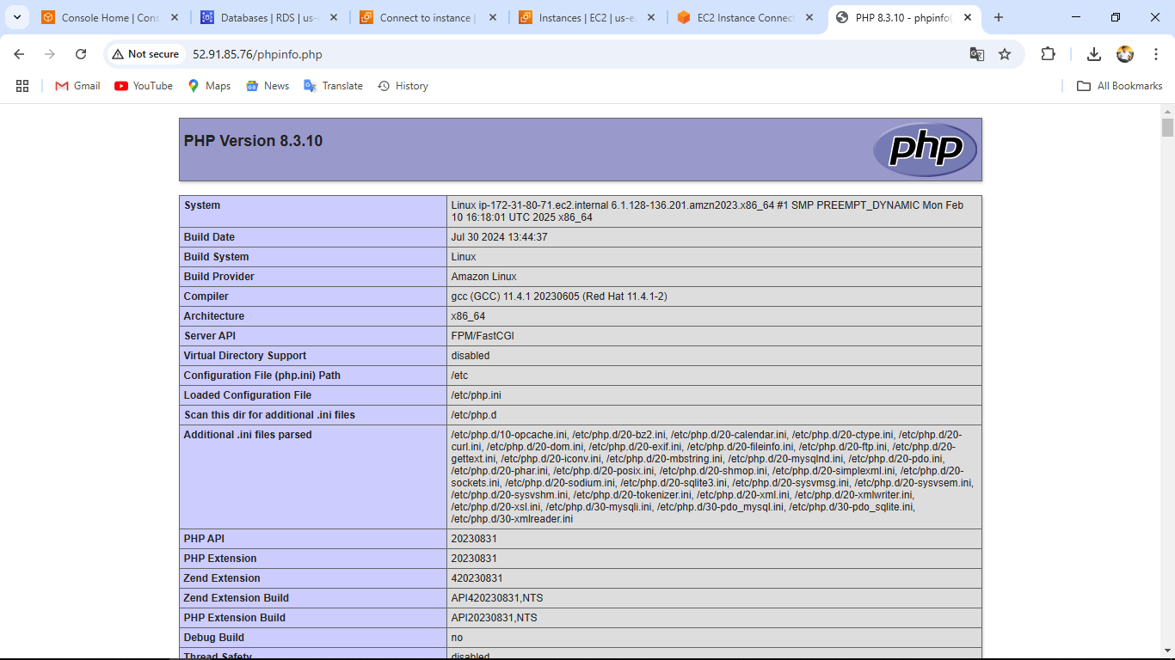
PHP INSTALLATION TEST PHP INFO PAGE

Slide 12
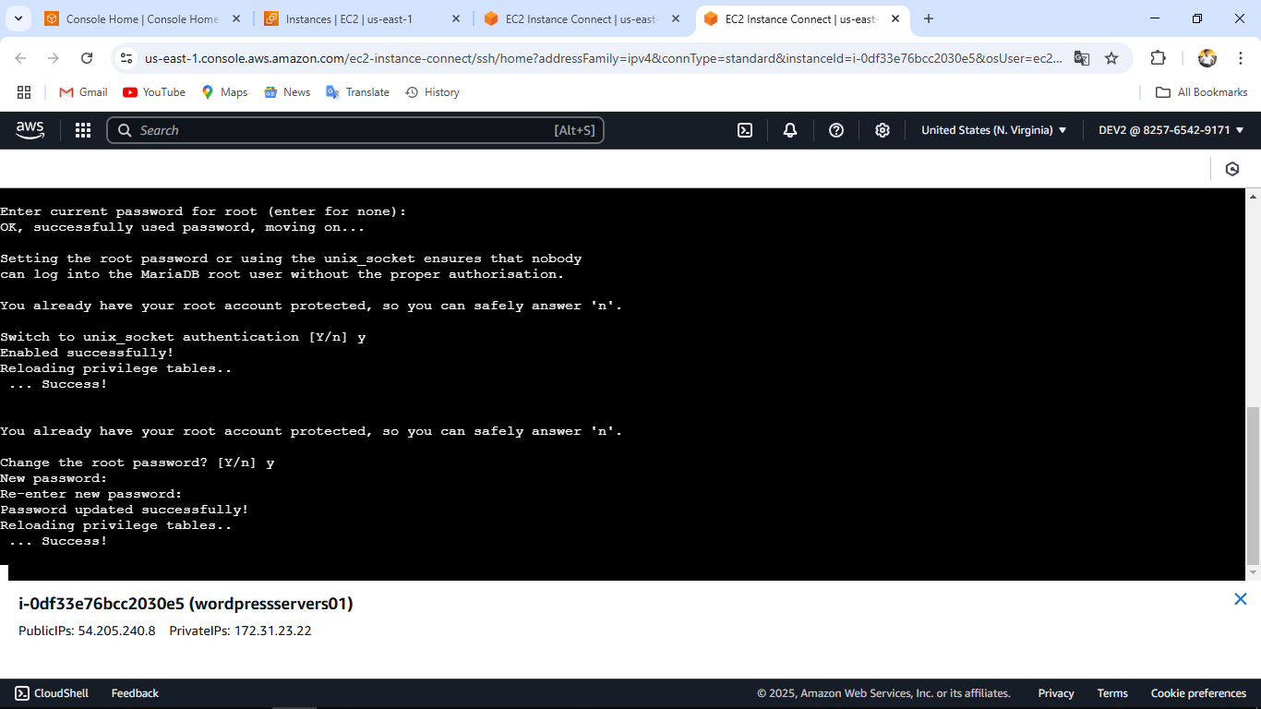
Start MariaDB Secure the MySQL installation with the mysql_secure_installation

Slide 13
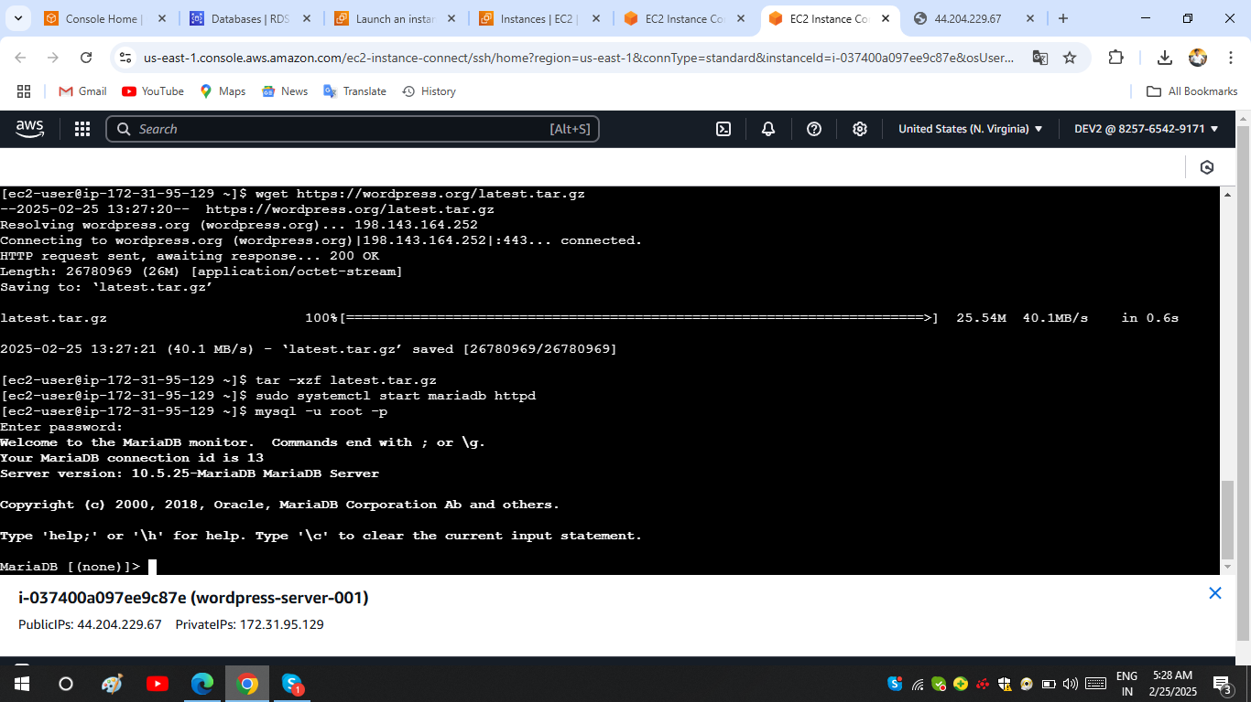
# Install WordPress

Slide 14
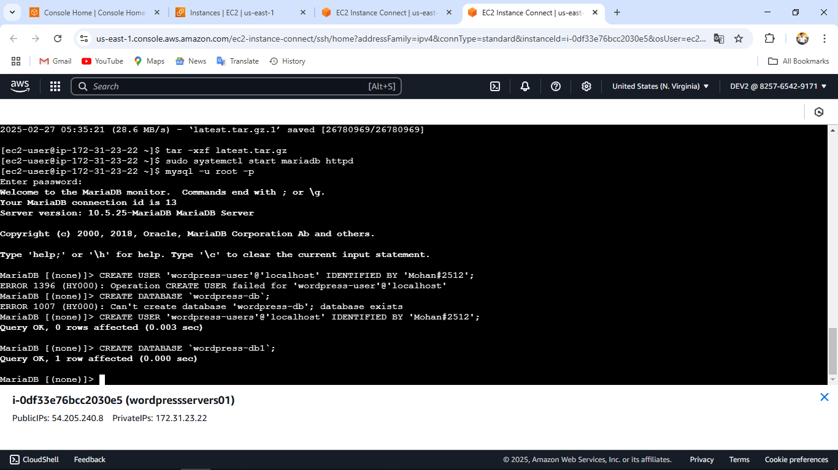
Create a Database for WordPress

Slide 15
ENTER PASSWORD

Slide 16
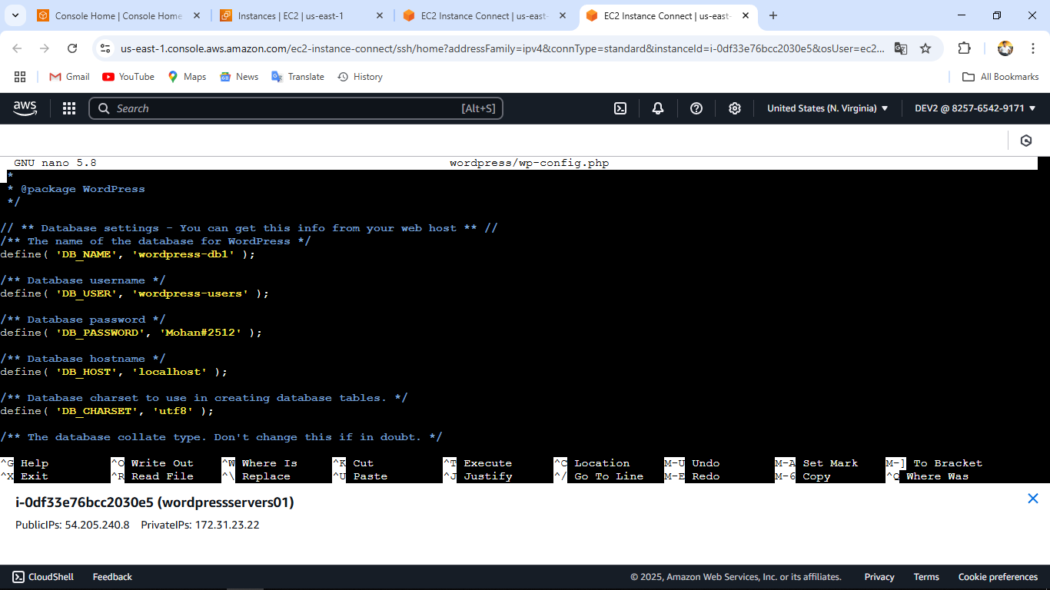
CONFIGURE WORDPRESS

Slide 17
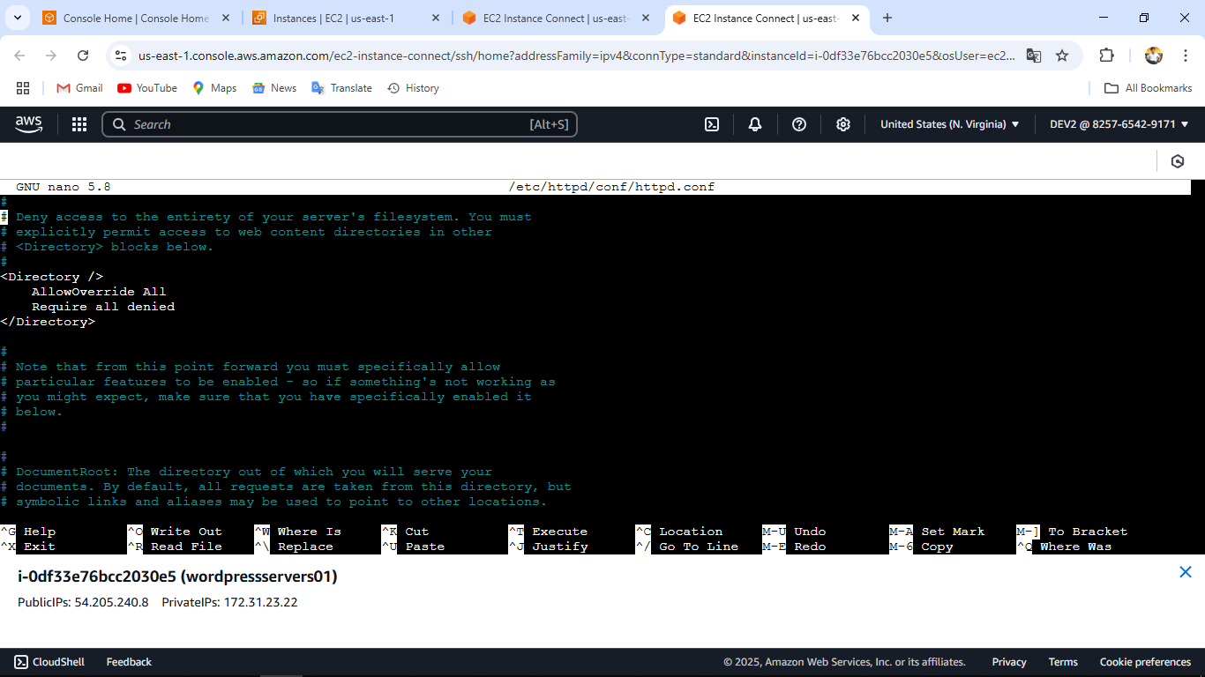
Configure Apache

Slide 18
FINALLIZE THE PROCESS
>> Change the AllowOverride None line in the above section to read Allowoveeride All
>> Restart Apache to apply the changes(sudo systemctl restart httpd)
>> complete your WordPress installation by navigating to
EC2 PUBLIC IP TO COPY THE ADDRESS TO SEARCH IN WEB

Slide 19
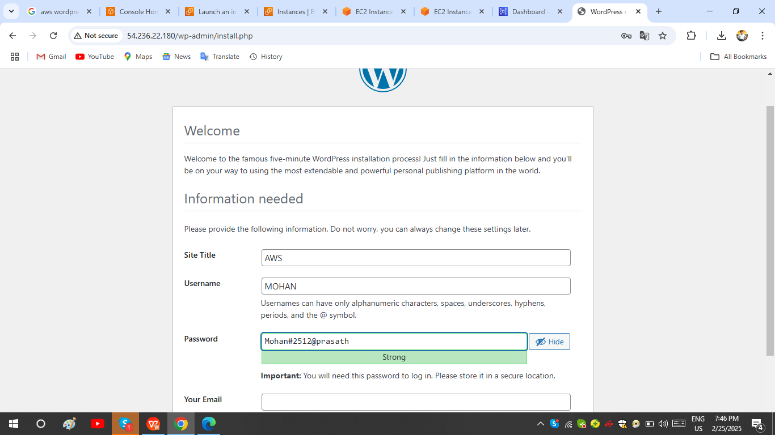
WELCOME TO WORDPRESS PAGE

Slide 20
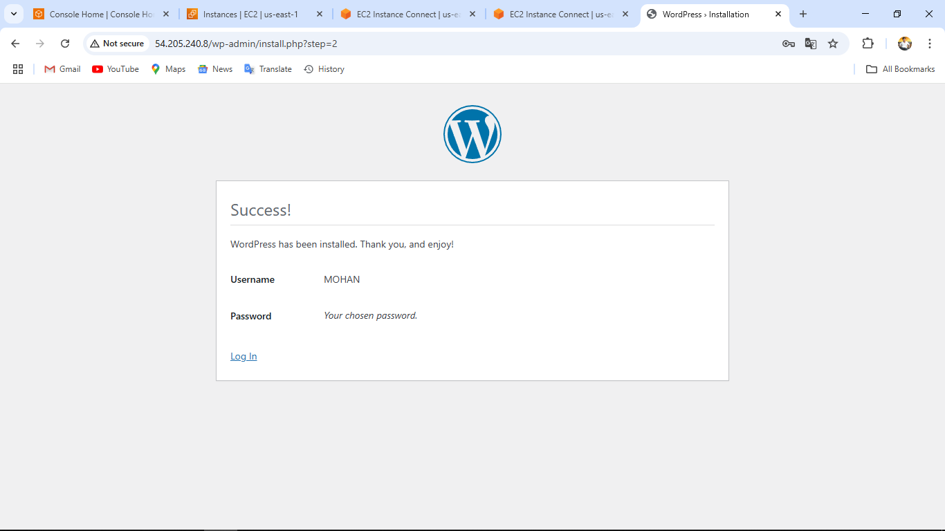
USER DETAILS

Slide 21
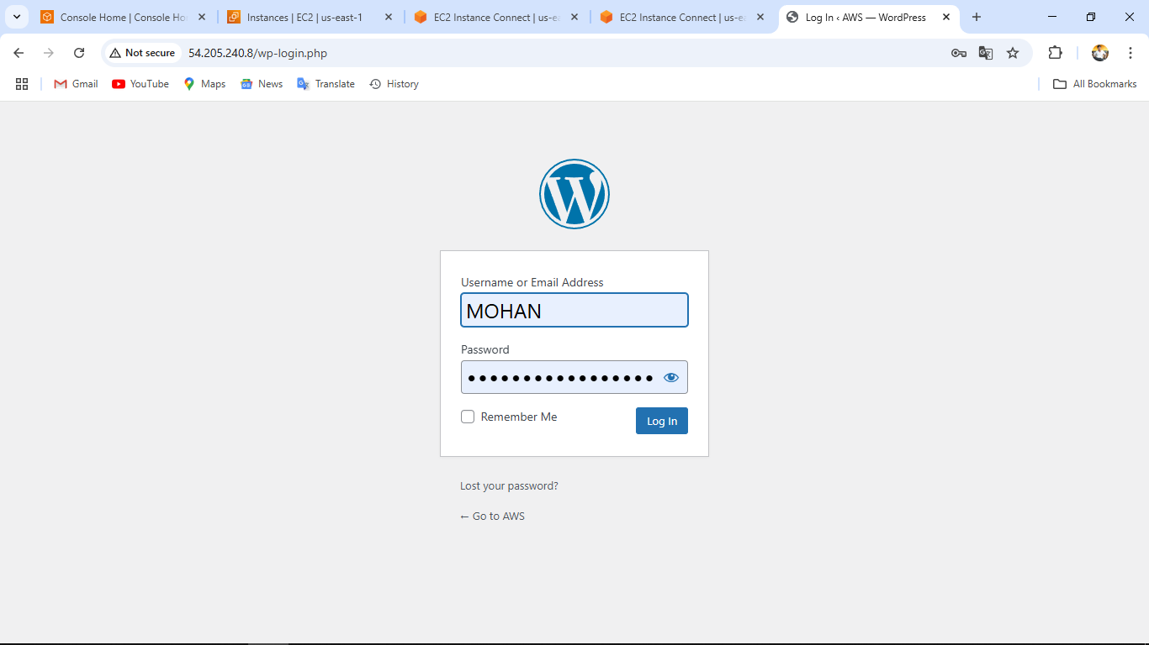
WORDPRESS LOGIN PAGE

Slide 22
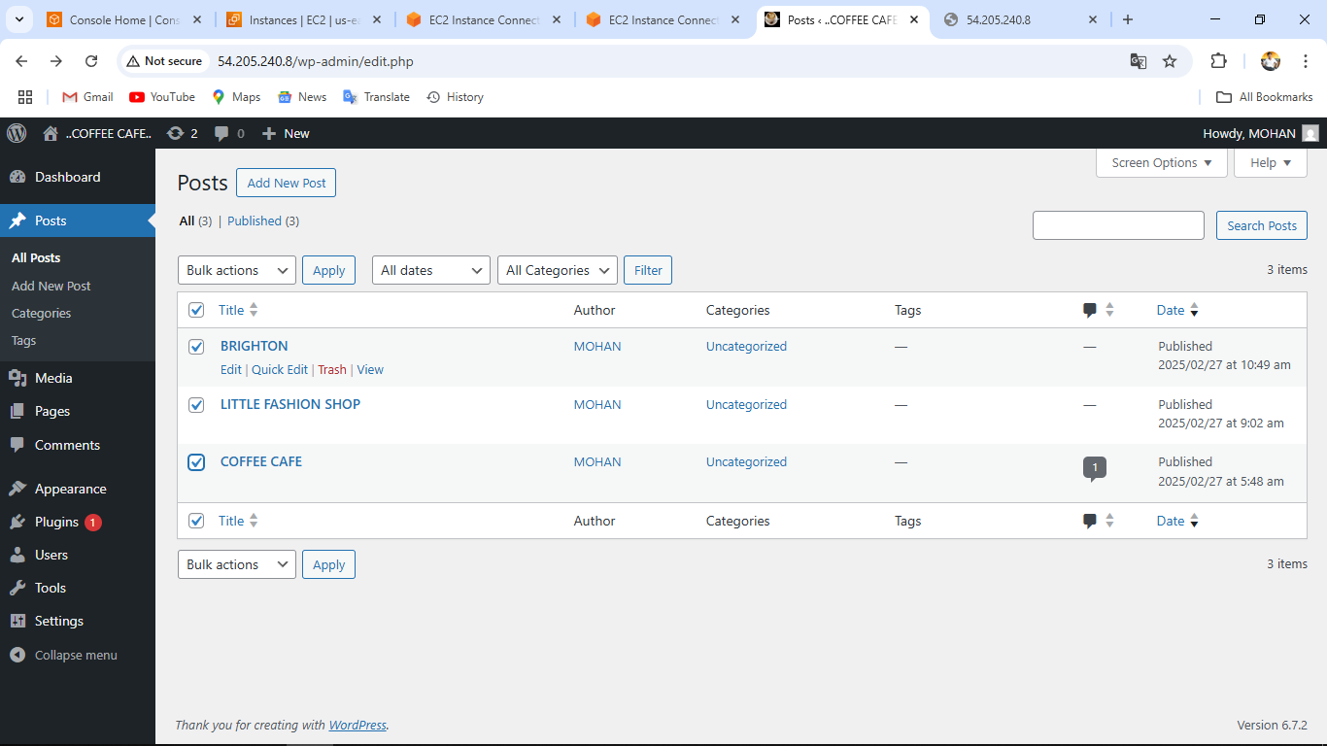
CONTENT PAGE

Slide 23
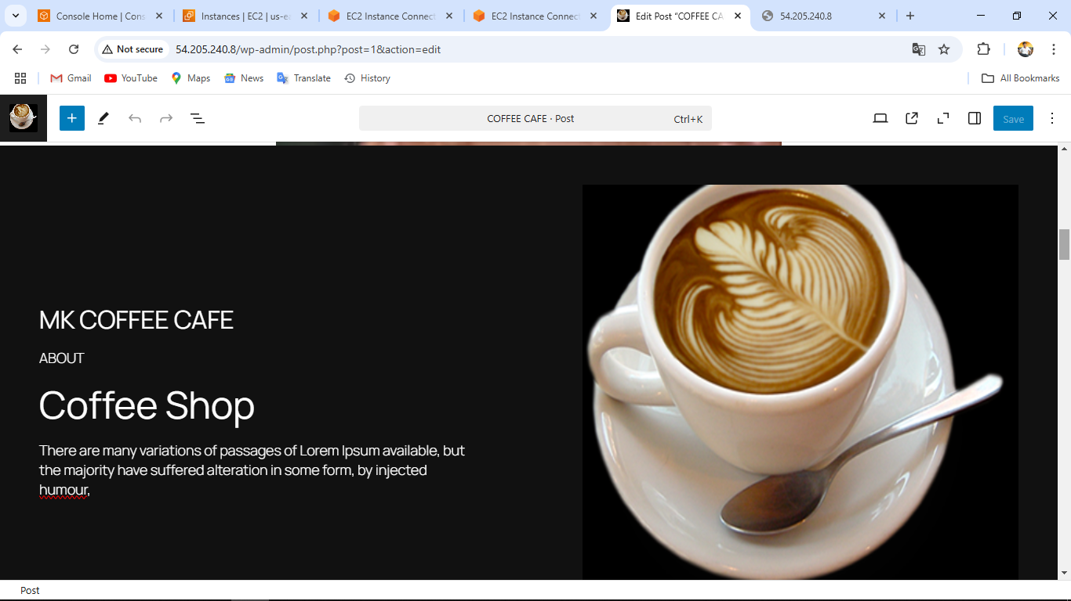
1. COFFEE CAFE WEBSITE

Slide 24
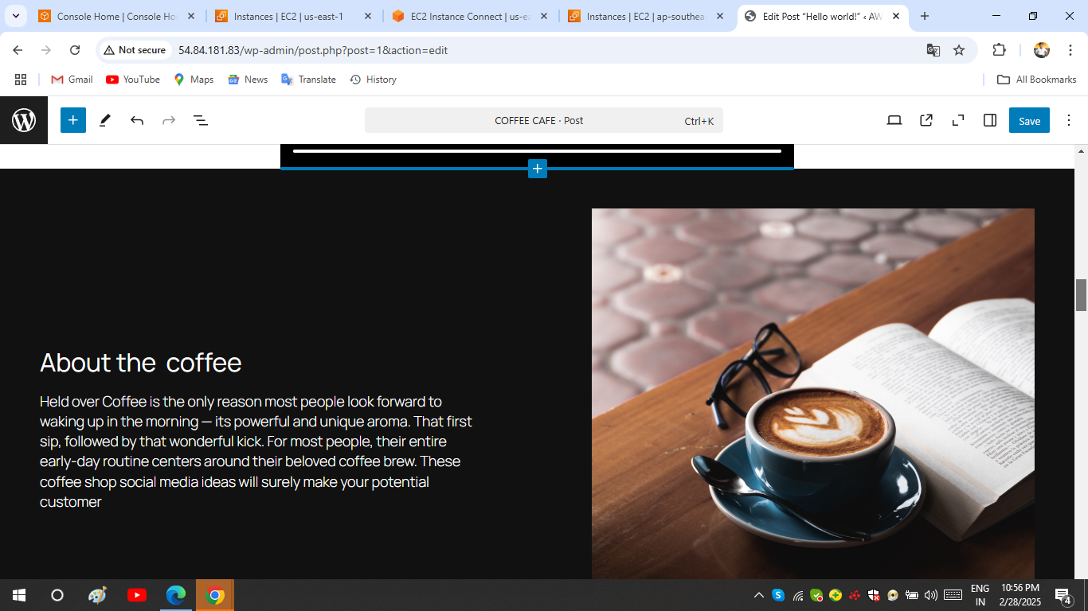

Slide 25
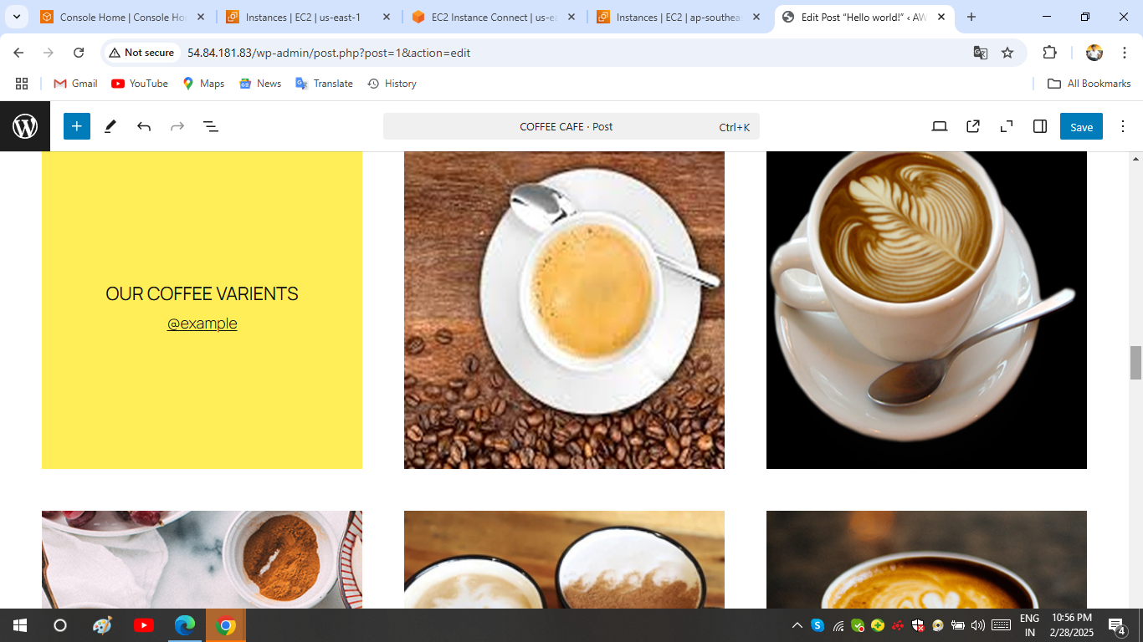

Slide 26
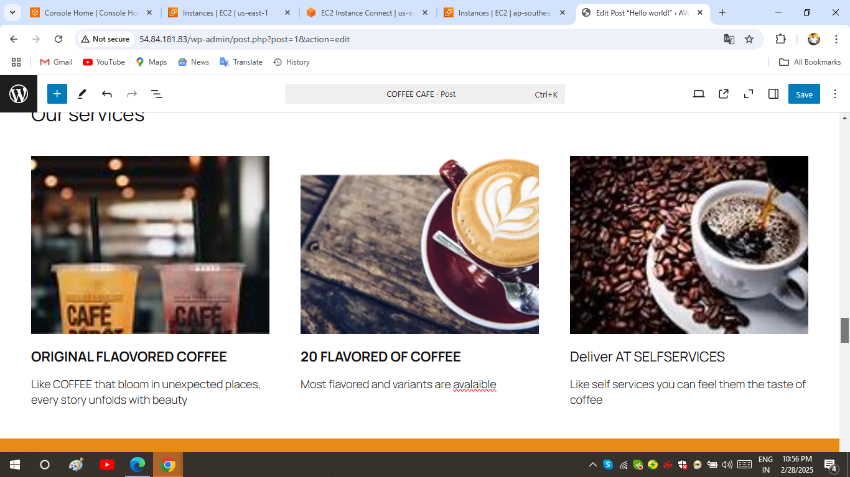
.

Slide 27
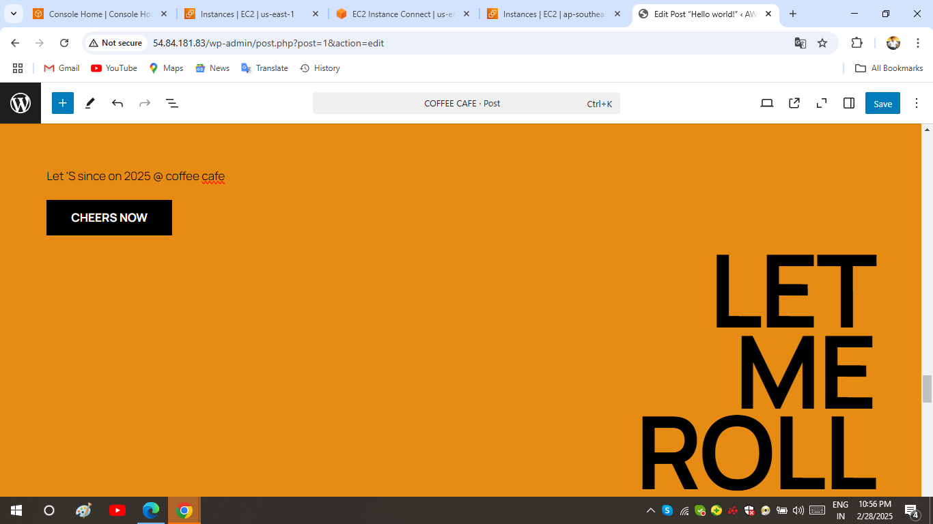
.

Slide 28
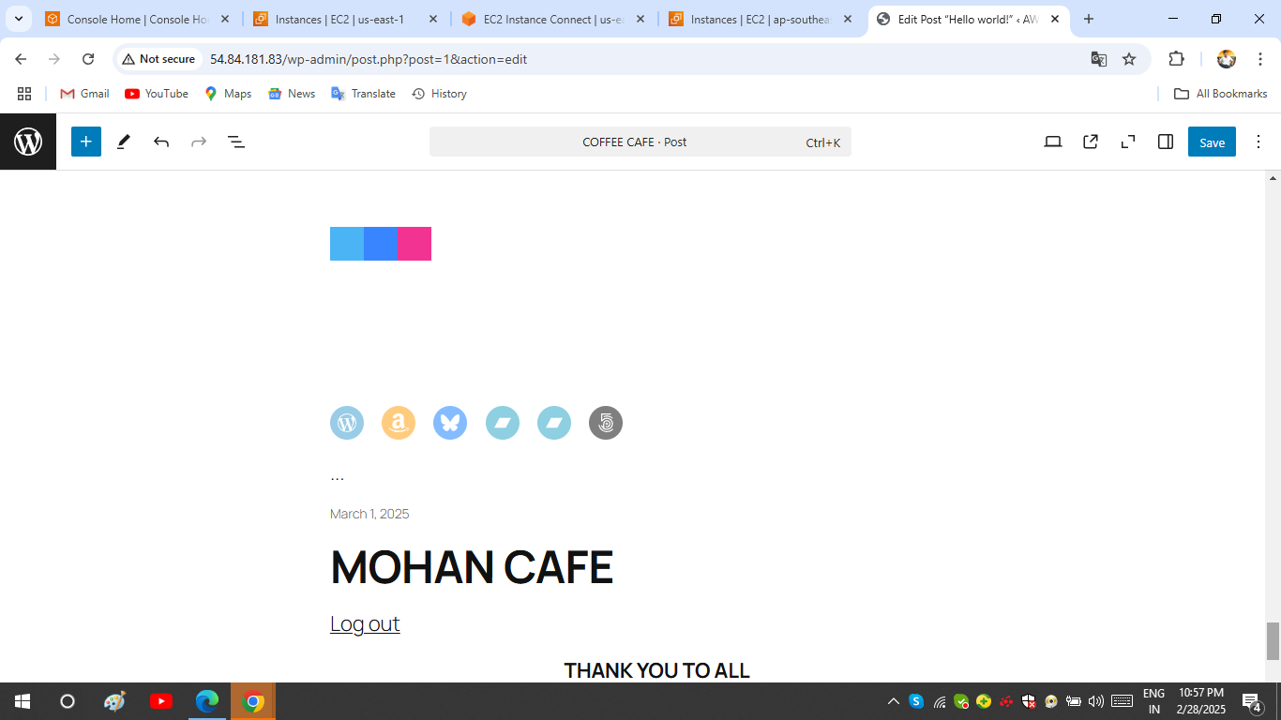
.

Slide 29
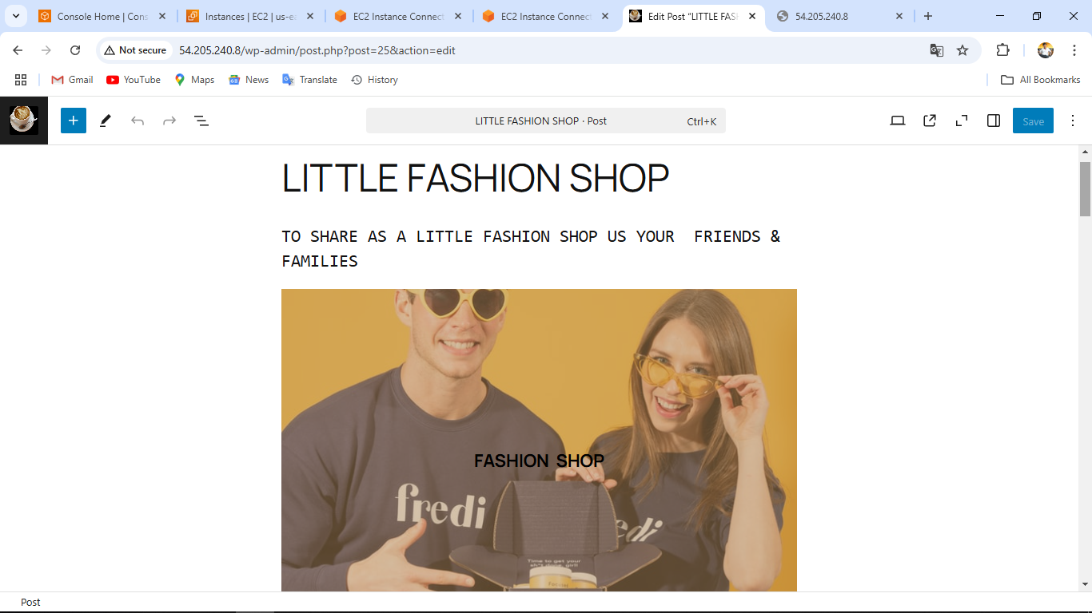
2. LITTLE FASHION SHOP

Slide 30
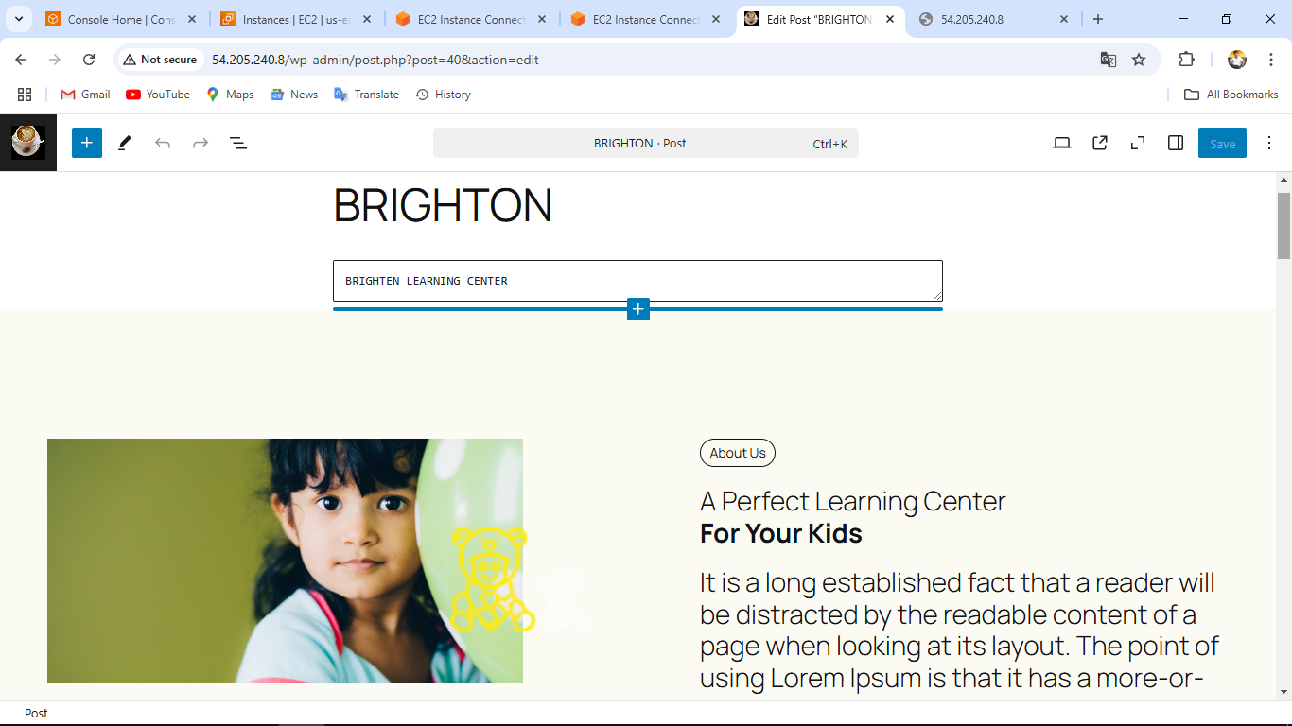
3. CHILD EDUCATION WEBSITE

Slide 31
..
THANK YOU

